Slide 1
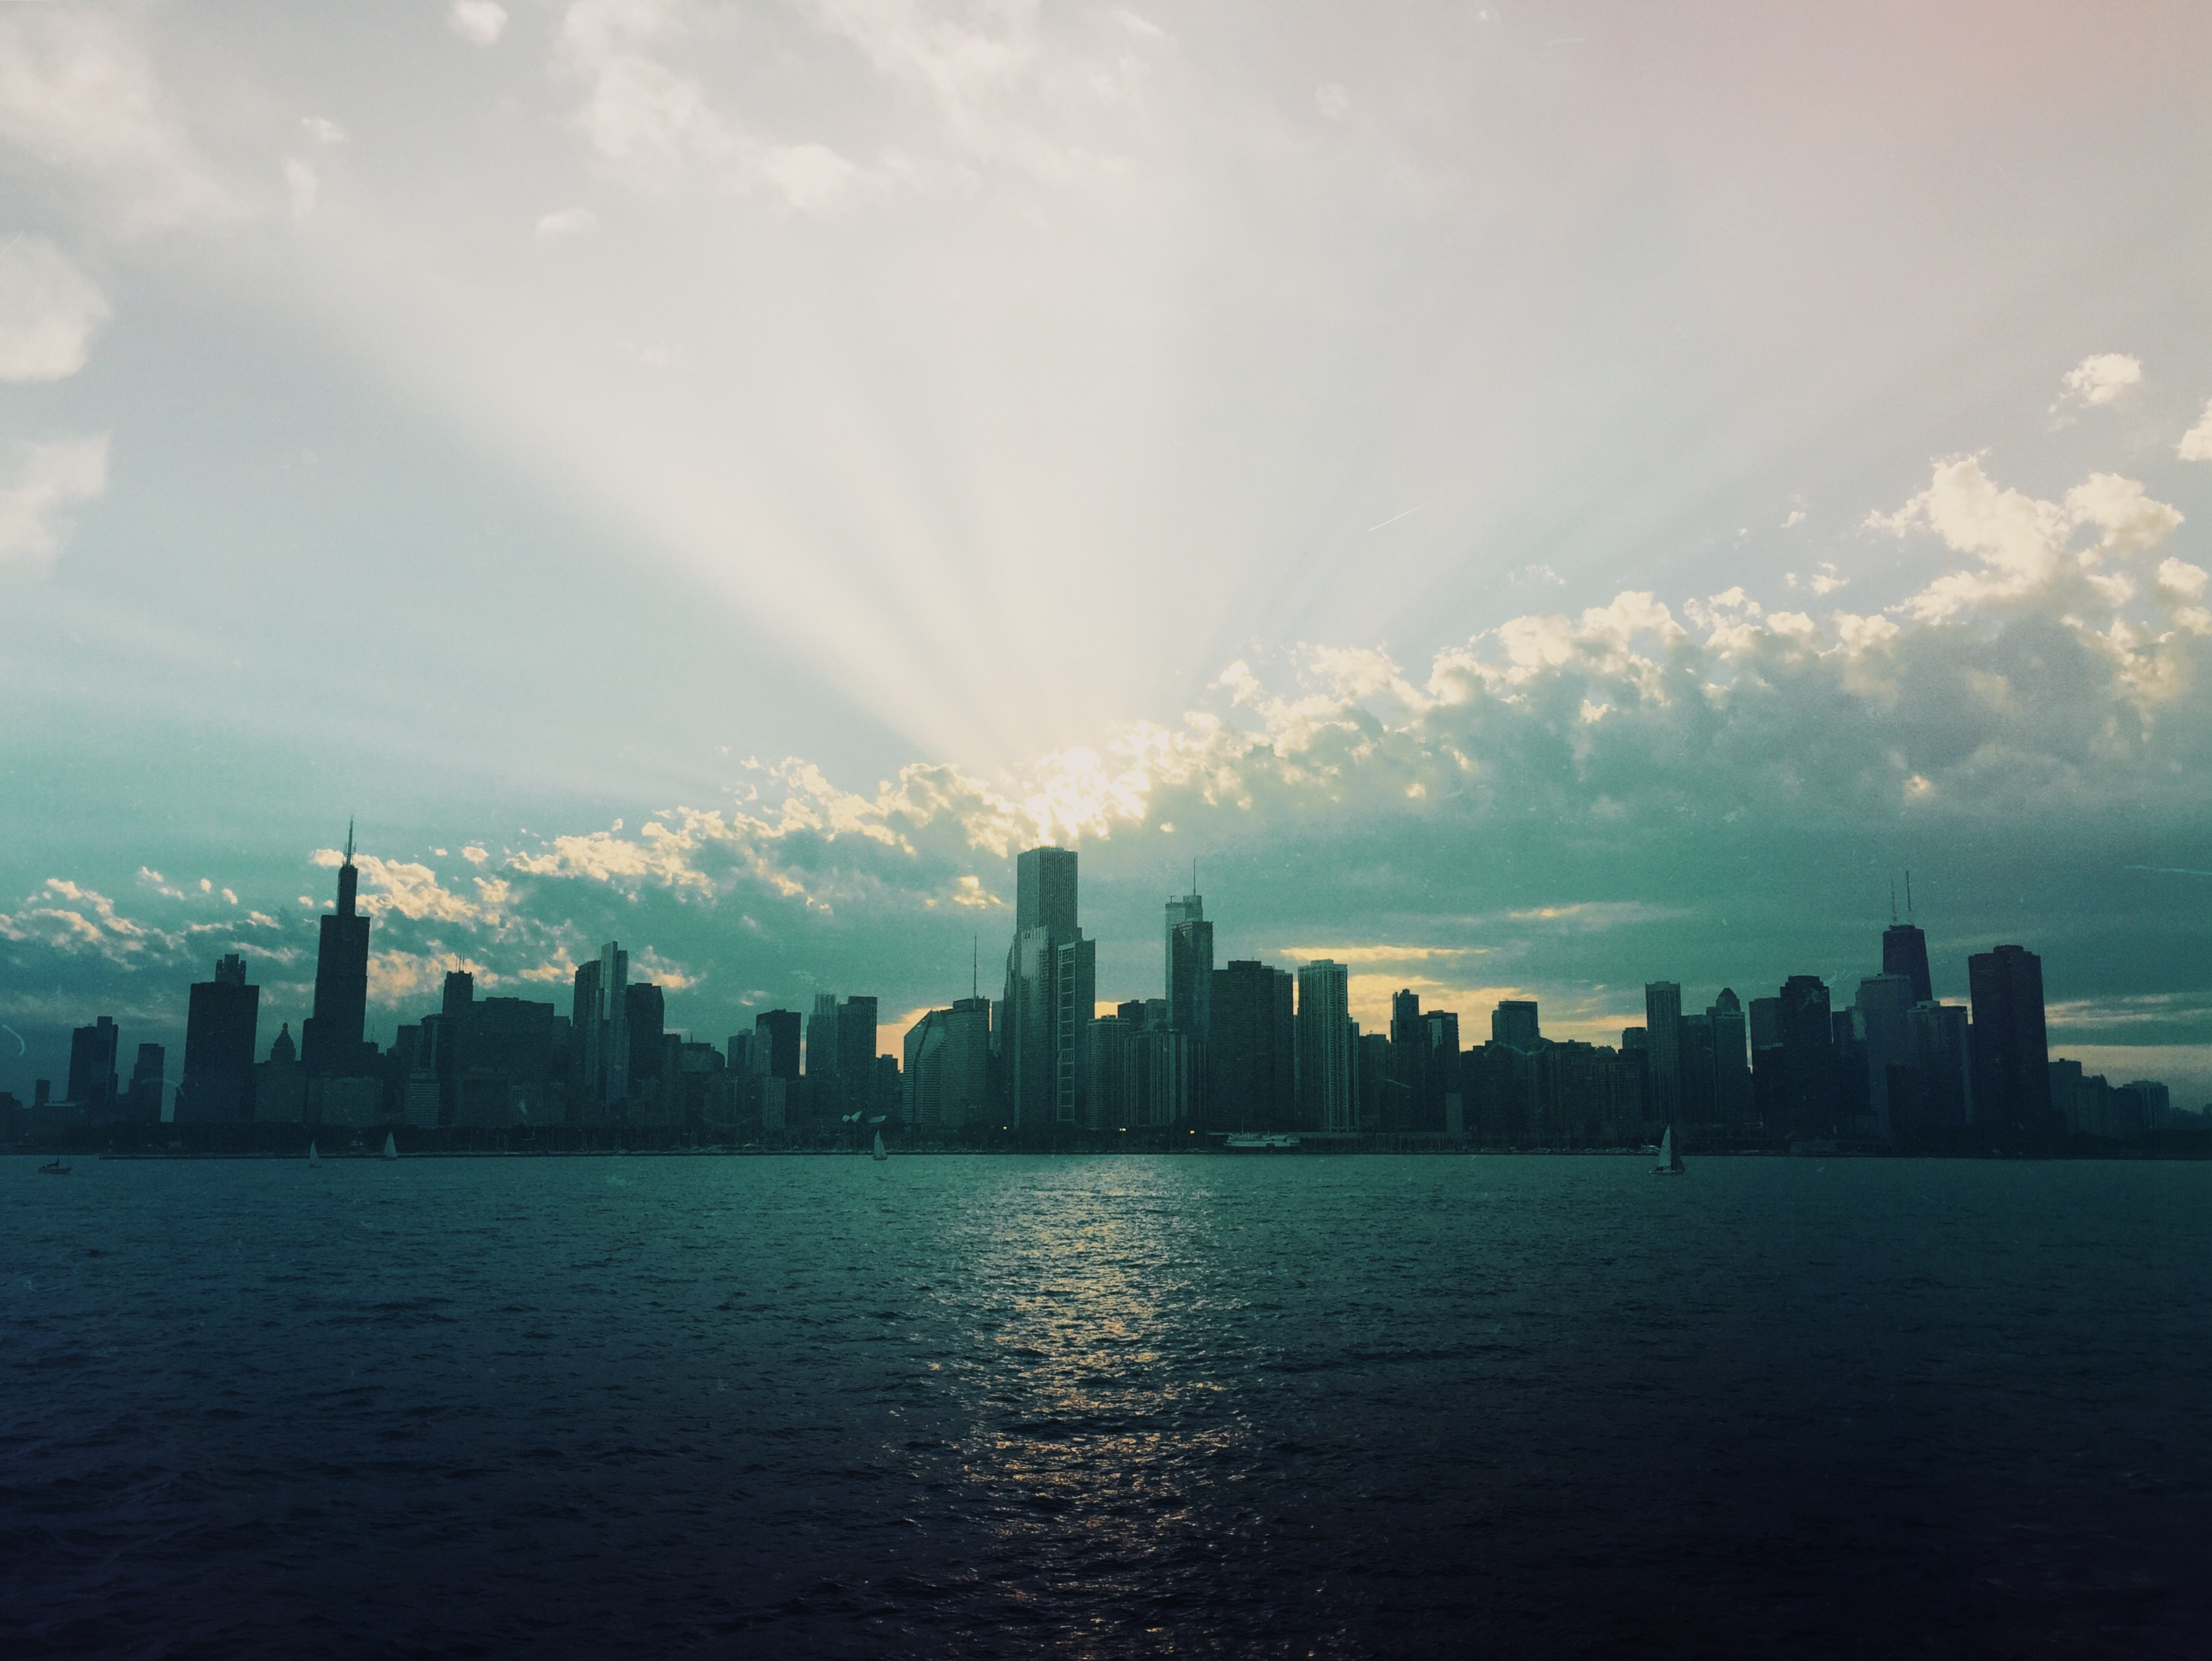
Chicago Landmarks
Historical sites, skyscrapers, and cultural institutions

Slide 2
The Windy City
Third largest city in United States
Incorporated in 1865
World’s first skyscraper built in 1885

Slide 3
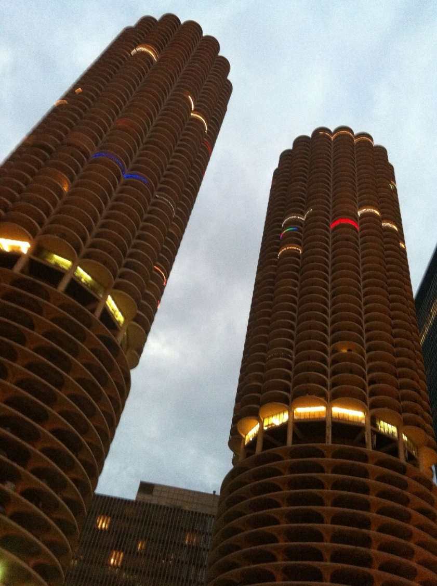
Marina City towers have been featured in many movies

Slide 4

Garfield Park Conservatory
Opened in 1874 and is a botanical treasure

Slide 5
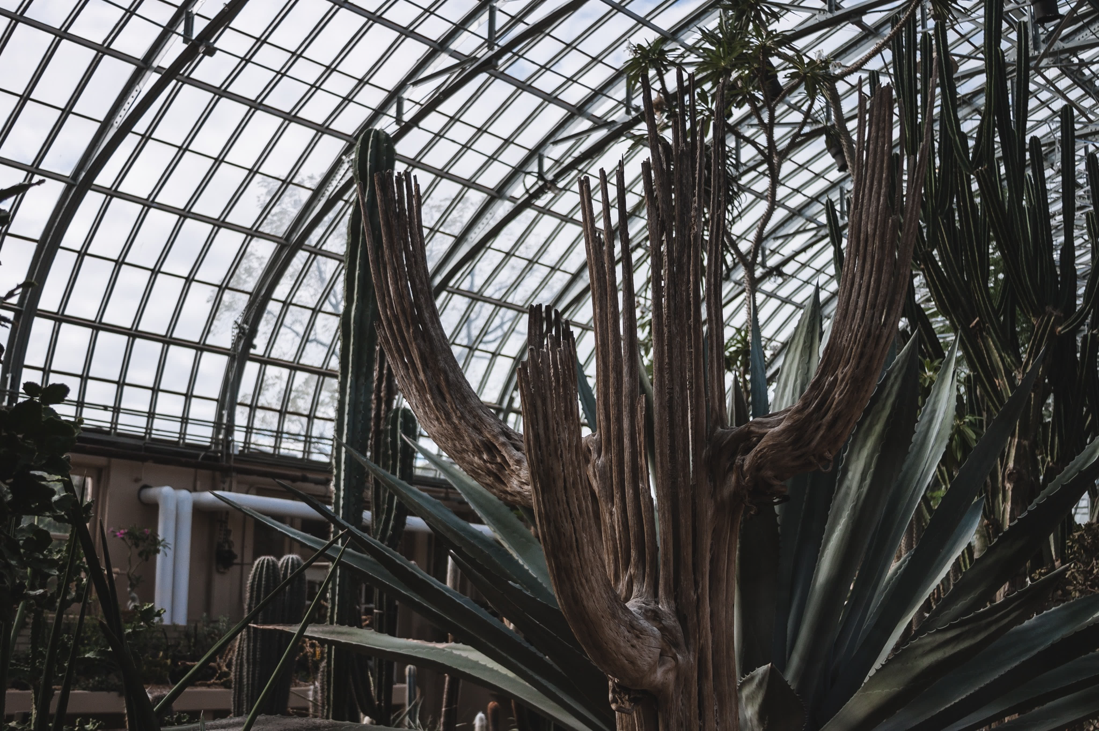

Slide 6
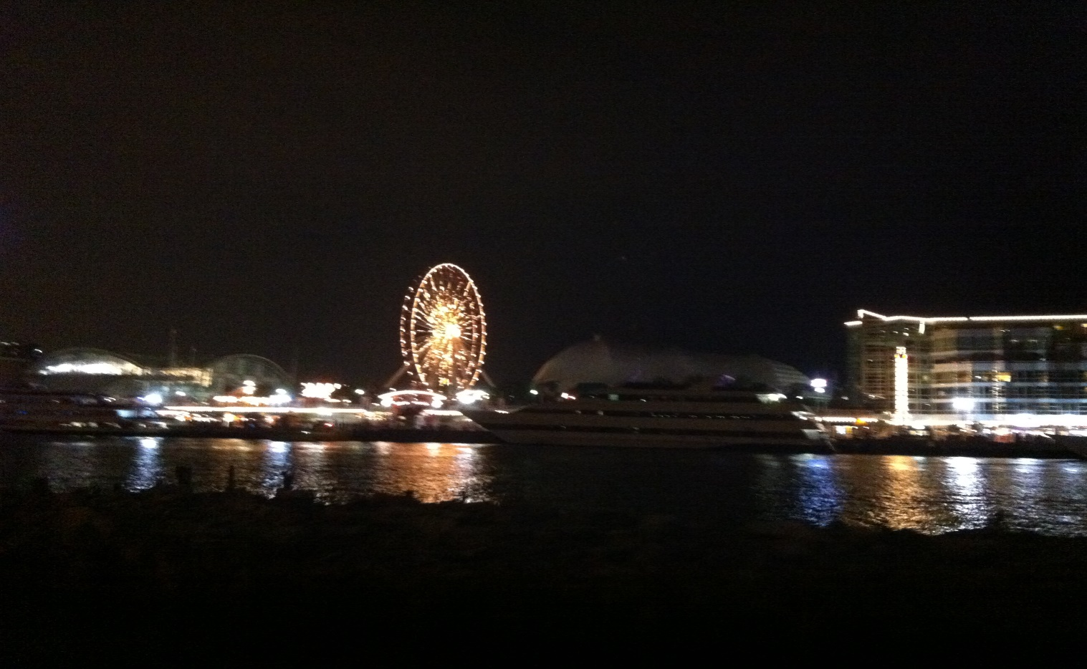
Navy Pier is known for its Ferris wheel, fireworks, attractions, and restaurants

Slide 7
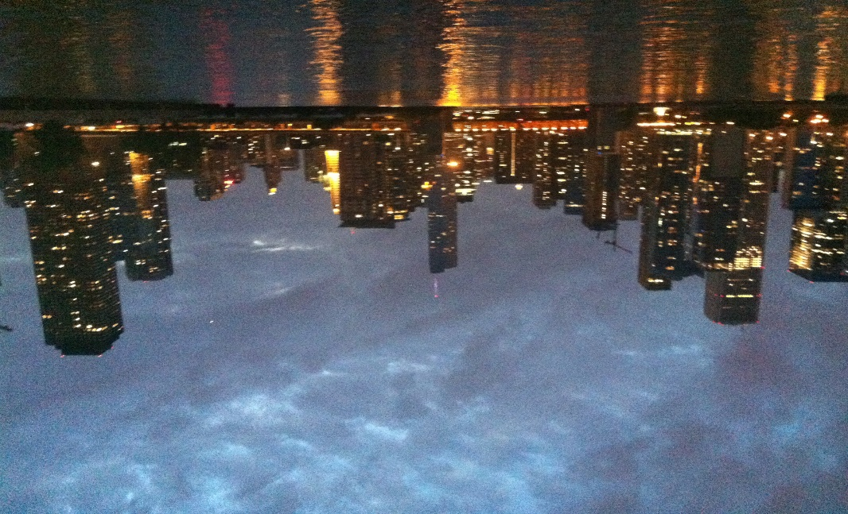
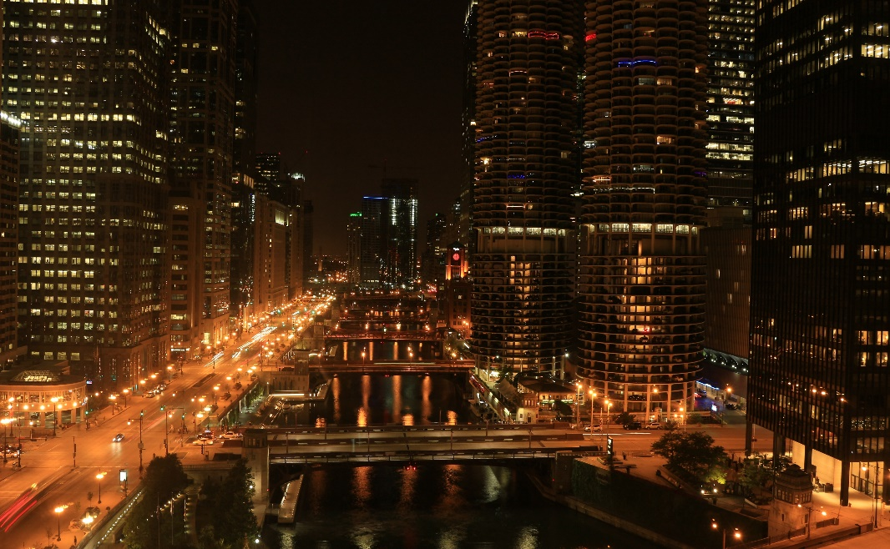
Evening cruises offer spectacular views of the city

